Slide 1
SQL Project
6th August 2020

Slide 2
Most Popular Artists
The most popular artists by tracks sold are dominated by metal/rock bands.
From the original database we can observe that the number of tracks sold by artists has a long tail, ie., there are many artists who have sold only a few songs.
The top 4 artists contribute about 19% of the overall value of tracks sold.

Slide 3
Most Popular Genres
Rock music is by far the most popular genre of music. Rock music, along with Latin, Metal and Alternative music are the most popular genres.
Rock music alone constitutes 37% of track sales while Rock, Latin, Metal and Alternative constitute over 77% od all tracks sold.
Rock & Roll and Science Fiction are the least popular genres.

Slide 4
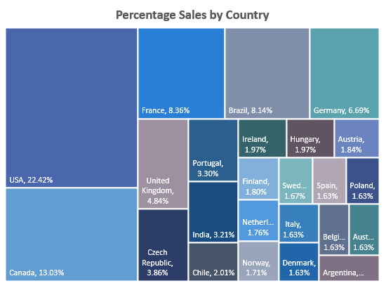
Percentage of Sales by Country
USA and Canada are the most popular countries in terms of track sales. North America alone constitutes about 35% of all sales.
The country with the highest sales in each continent are:
N.America – USA
S.America – Brazil
Europe – France
Asia – India
Oceania - Australia

Slide 5
Sales by Year
Sales over time have been mostly consistent but there is no clear trend.
The year with most sales was 2010 while the year with least sales was 2009.
Average sales are 466/year.

